Slide 1

Introduction to Mobile Development with Xamarin
Speaker Name
Speaker Title
@TwitterAccount
name@email.com

Slide 2
Agenda
What is Xamarin?
Demo
.NET
Under the Hood
Integrations
Xamarin.Forms Overview
Visual Studio

Slide 3







.NET: Your platform for building anything
Desktop
Web
Cloud
Mobile
Gaming
IoT
AI
.NET
Notes:
As developers we need to be able to reach every platform on the planet. And that is the goal of .NET enabling developers to build for these devices with unique frameworks optimized for each.
Today, we will look at what the Xamarin platform and framework, which are part of .NET offer.

Slide 4
What is Xamarin?
Notes:
So, let’s start with exactly what Xamarin is.

Slide 5
An open source app platform
from Microsoft for
building modern & performant
iOS, Android, macOS,
watchOS, & tvOS apps with .NET.

Slide 6
Why Xamarin Now?
Notes:
So why is Xamarin so important for developers right now?

Slide 7

Software drives more of the things we do every day.
Notes:
Every day more and more of the things that we do are completely being driven by software. From sending an email, to ordering a pizza, to driving our cars, software is there and we need to be able to reach them.

Slide 8
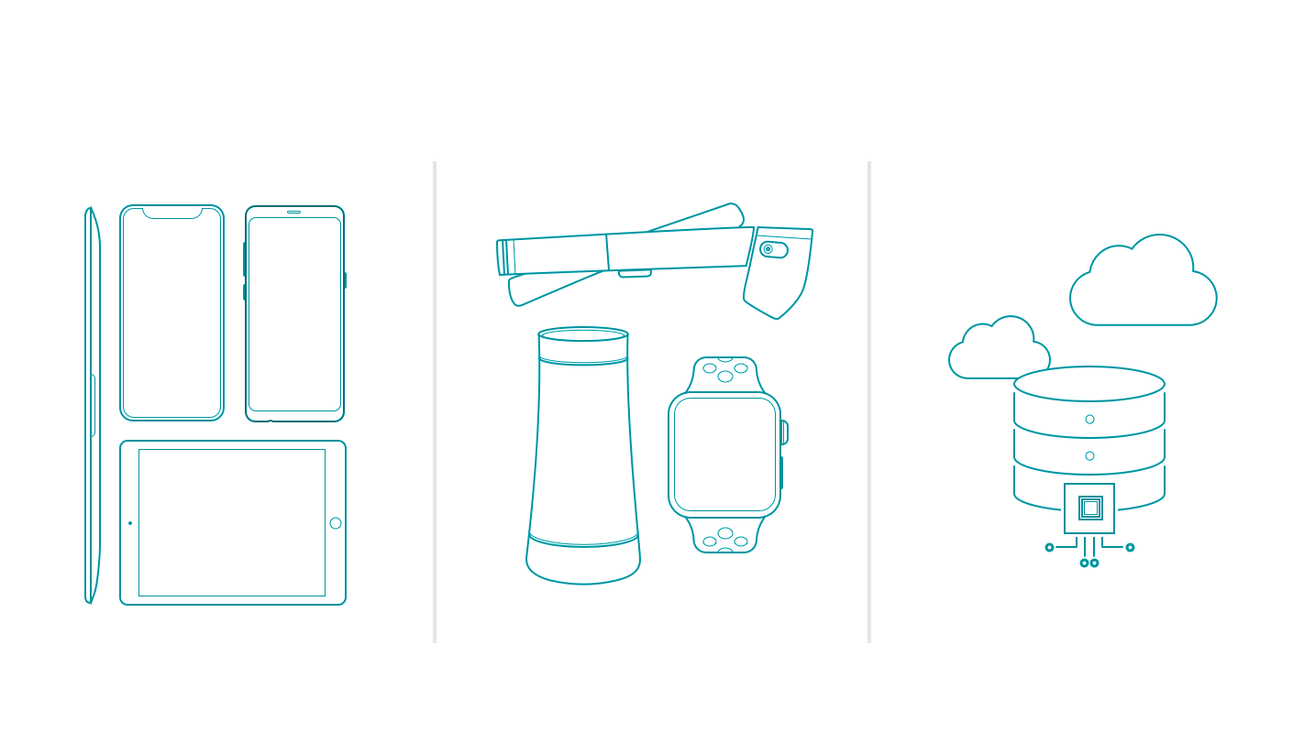
New challenges
More devices
Emerging platforms
Data & intelligence
Notes:
Additionally, there are more devices, platforms, and extensions into the world of AI and machine learning. That is where Xamarin can help .NET developers. In fact there are tons of companies that entrust Xamarin and .NET today.

Slide 9



























Xamarin
Loved by developers, trusted by enterprise
Notes:
In fact there are tons of companies that entrust Xamarin and .NET today.
These companies leverage Xamarin and .NET across all verticals and all different types of platforms.

Slide 10
App Development With Xamarin
Notes:
So, let’s get into how we build apps with Xamarin.

Slide 11
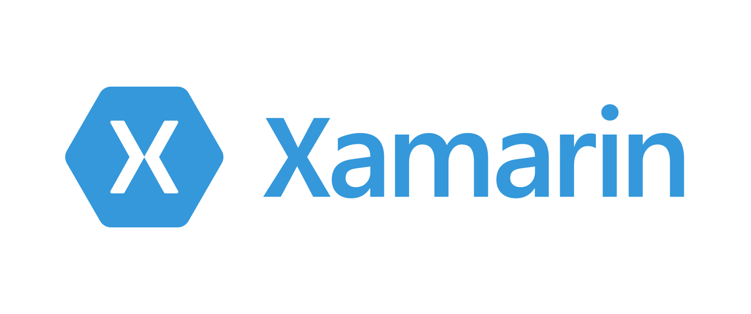




Productive environment
Maximize code reuse
Native performance & integrations
Expansive ecosystem
Notes:
Xamarin has a goal of delivering on these for core principals. Each of them are exactly what developers need to be super productive. Let’s walk through how Xamarin does this.

Slide 12

Xamarin App Architecture
.NET
C#
C#
C#
Shared C#
Business Logic • Platform APIs • User Interface
Shared C# codebase • 100% native API access • High performance
Notes:
First, it is with it’s unique application architecture. In fact it is the .NET architecture itself. You decided what platforms you want your apps to run on, we call them head projects.
You can access all of the native APIs for each and share a bulk of the C# logic. Here we see business logic, platform APIs, and user interfaces. This can scale to a lot or a little based on what you are trying to achieve. So how exactly does this work?

Slide 13
Windows APIs
Windows.Media
Windows.Networking
Windows.Storage
Windows.Foundation
Windows.Devices
System.Net
System
System.IO
System.Linq
System.Xml
System.Data
System.Windows
System.Numerics
System.Core
System.ServiceModel
C#
Notes:
With .NET and Window development we always had the .NET Framework which offers tons of APIs for developers to use. When you want to target desktop or web, you download a SDK and get platform APIs.

Slide 14
Xamarin.iOS
MapKit
UIKit
SiriKit
ARKit
CoreML
System.Net
System
System.IO
System.Linq
System.Xml
System.Data
System.Windows
System.Numerics
System.Core
System.ServiceModel
C#
Notes:
What the Xamarin platform does for iOS, Android, macOS, watchOS, and tvOS is bring .NET directly to them and the platform delivers “C# bindings” around the native APIs. So you have access to everything, directly in C#.
Here we see just a few of the thousands of APIs available for iOS

Slide 15
Xamarin.Android
Fingerprint
Bluetooth
Picture-in-Picture
Geolocation
NFC
System.Net
System
System.IO
System.Linq
System.Xml
System.Data
System.Windows
System.Numerics
System.Core
System.ServiceModel
C#
Notes:
The same is true for Android with thousands of APIs beyond these. In addition, the Xamarin platform delivers essential integrations which we will talk about such as Google Play services and the support libraries.

Slide 16

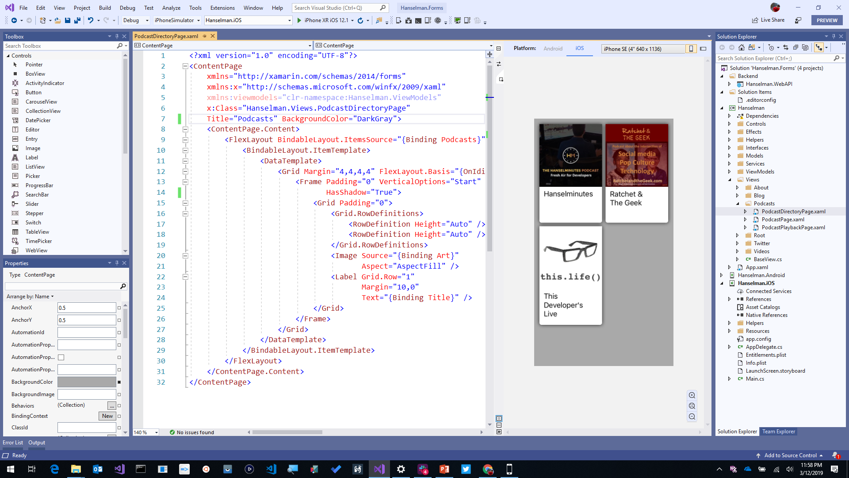
Visual Studio 2019
iOS, Android, Desktop, Web, Cloud, and More!
Advanced IntelliSense & Code Cleanup
Enhanced Collaboration with Live Share and Pull Request Experience
Advanced Debugger & Search Windows
Simple Connected Services to Deploy to Azure
Notes:
All of this work can be done in an astonishing IDE, Visual Studio! You can harness the complete power of this IDE and all of it’s amazing Intellisense, code cleanup, and extensions, and build iOS and Android apps directly on your Windows PC.

Slide 17

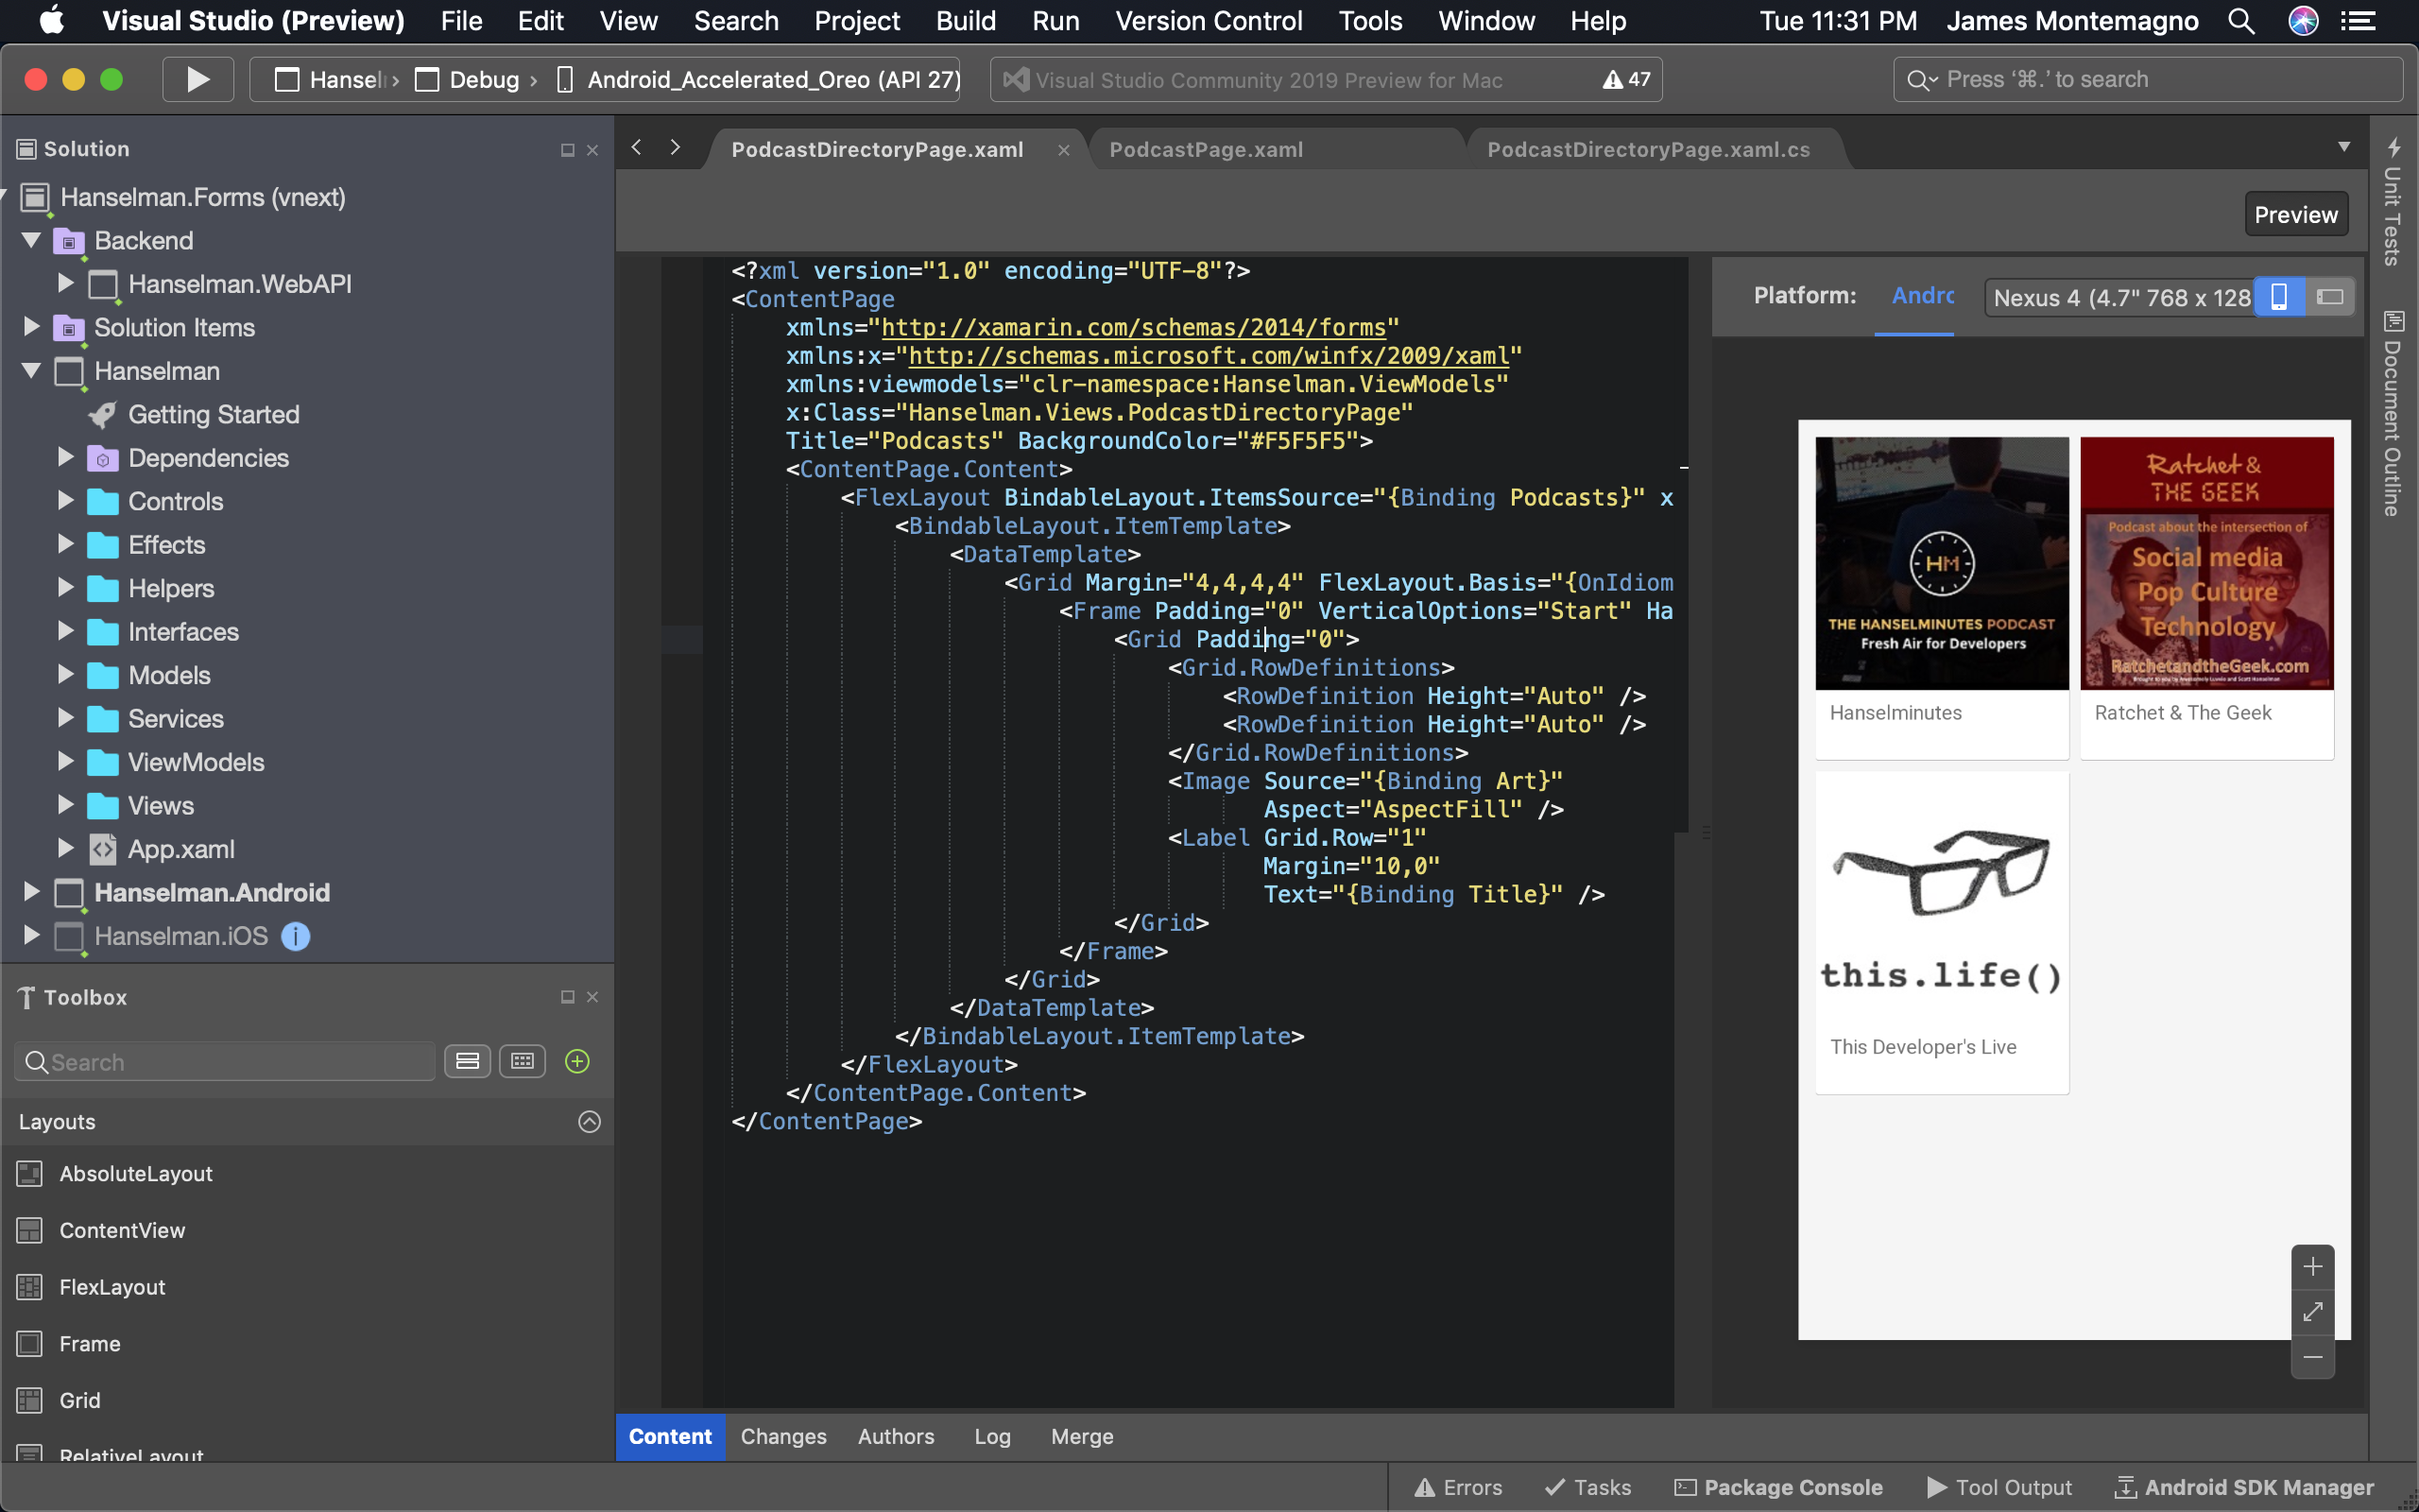
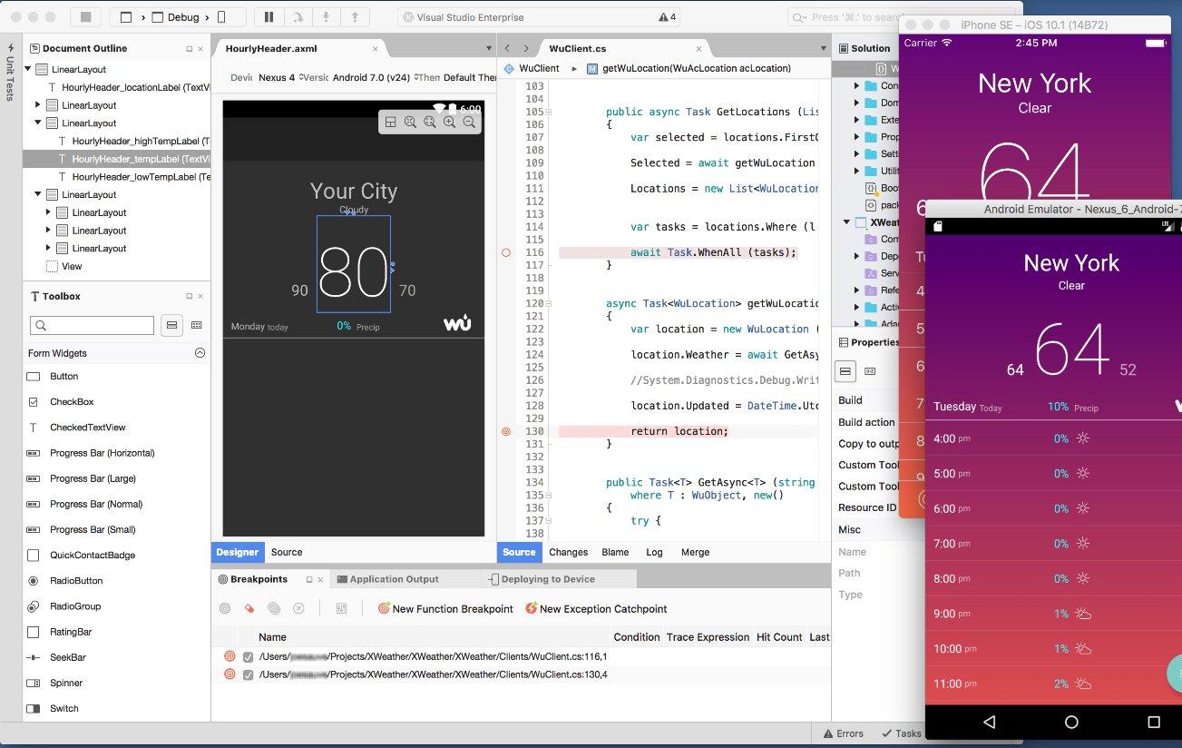
Visual Studio 2019 for Mac
.NET Centric
Focused on .NET Developers
.NET Core
ASP.NET Core Web Apps & APIs
Unity
Develop and Debug Unity Game Code
Xamarin
Mobile: Android, iOS, watchOS
macOS, tvOS
Azure
Connected Services
Easy Deployment
Azure Functions
Notes:
Best of all there is Visual Studio for Mac, bringing many workloads from Windows directly to macOS. The same projects and same solutions open.

Slide 18
Demo: Xamarin Development
Notes:
Let’s walk through building out a simple app with Xamarin leveraging .NET and a shared logic base for the business logic, native API access, and the user interface. After this we will talk about the different libraries that the Xamarin platform offers to power this scenario.
We will build out a simple app that allows us to enter text and send a tweet. After that we will look at a more complex app that calls into an ASP.NET Core Web API backend.

Slide 19

https://youtu.be/97jI9_JUbVY
Notes:
This is a video walkthrough with no audio if you need to play it back. You will need internet connectivity, or download it ahead of time. Feel free to contact motz@Microsoft.com

Slide 20
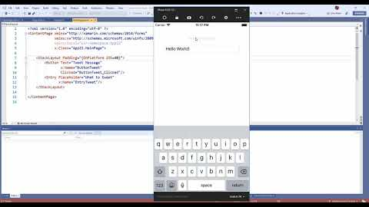
Notes:
This is a video walkthrough with audio.

Slide 21
.NET
Notes:
Let’s first talk bout code sharing and the .NET Ecosystem that Xamarin is part of.

Slide 22











.NET – A unified platform
TOOLS
DESKTOP
WEB
CLOUD
MOBILE
GAMING
IoT
AI
VISUAL STUDIO
.NET
VISUAL STUDIO FOR MAC
LIBRARIES
VISUAL STUDIO CODE
INFRASTRUCTURE
RUNTIME COMPONENTS
COMPILERS
LANGUAGES
COMMAND LINE INTERFACE
Notes:
Just like we saw earlier .NET is a platform to target everything, it is also a unified platform enabling you to share your libraries across all of the different platforms that you want to target. You can also build your apps with several different tools.

Slide 23
No better time to be a .NET developer
Notes:
.NET is growing at an exponential growth curve. Let’s take a look.

Slide 24



.NET ecosystem
+1M New
.NET developers in last year
>750K
.NET Core developers
Top 30
Highest velocity OSS projects
on GitHub
.NET Core
Top 10
Language=C#
8x
Faster than Node.js
>550 repositories
>61K accepted community PRs
>12K contributors
>87% outside of Microsoft
GitHub
ASP.NET Core
.NET Foundation
Notes:
As a whole .NET is adding millions of .NET Developers, growing in open source, and the languages that power it are top tier.

Slide 25

.NET Open Source Success
“Samsung is embracing .NET because it is a completely open source project.” — Samsung
".NET is open source; that allows us to contribute back to it if we have any performance issues which Microsoft review and together we make a better product.“ — Illyriad Games
61,000+ Community Contributions from 3700+ Companies outside Microsoft
Notes:
Xamarin isn’t only open source but a bulk of .NET itself is open source. The community and companies using .NET have been contributing at a huge growth rate.

Slide 26


Steeltoe
.NET Core
Microsoft Web Protection Library
MSBuild
DotNetNuke
ASP.NET AJAX Control Toolkit
ASP.NET Core
SourceLink
Microsoft Azure WebJobs SDK
Salesforce Toolkits for .NET
nUnit
MVVM Light Toolkit
IronPython
Mailkit
WorldWide Telescope
Nancy
Open XML SDK
.NET SDK for Hadoop
MvvmCross
MEF
Mimekit
xUnit
ASP.NET Web Pages
NuGet
IdentityManager
Couchbase Lite for .NET
iOS
macOS
Entity Framework
.NET ECOSYSTEM
WCF
ILMerge
Xamarin.Mobile
ASP.NET SignalR
.NET Micro Framework
Open Live Writer
Mono
Xamarin.Auth
Xamarin SDK
Orchard CMS
OWIN Authentication Middleware
ProtoBuild
IdentityServer
Microsoft Azure SDK for .NET
.NET Compiler Platform ("Roslyn")
Prism
ASP.NET Web API
Cake
Orleans
Kudu
Cecil
LLILC
Umbraco
System.Drawing
ASP.NET MVC
Notes:
A core foundation of .NET is the .NET Foundation that is run by the .NET community and supports .NET projects and the community.

Slide 27
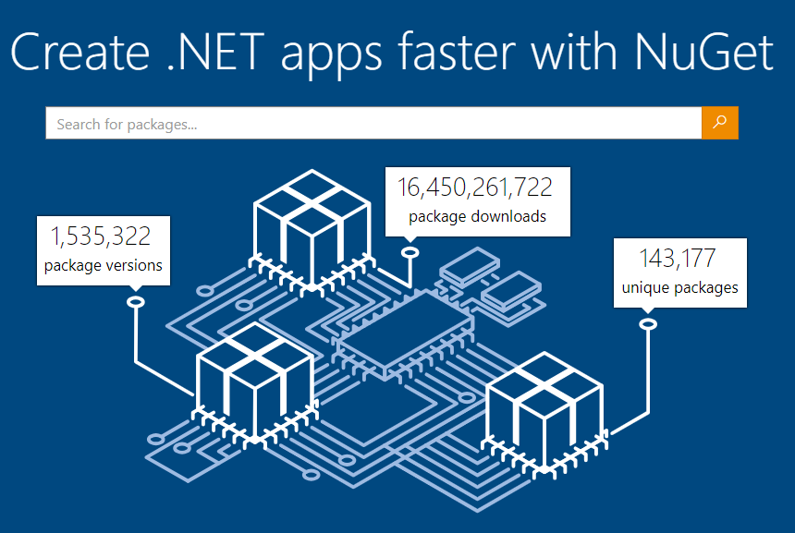
Notes:
What brings it all together is a great packaging system with NuGet that is compatible with any of the platforms and frameworks. Enabling you to get access to any library you may need.

Slide 28
Under the Hood
Notes:
Now that we know how Xamarin fits into .NET, let’s take a look at the technology that is powering these apps.

Slide 29
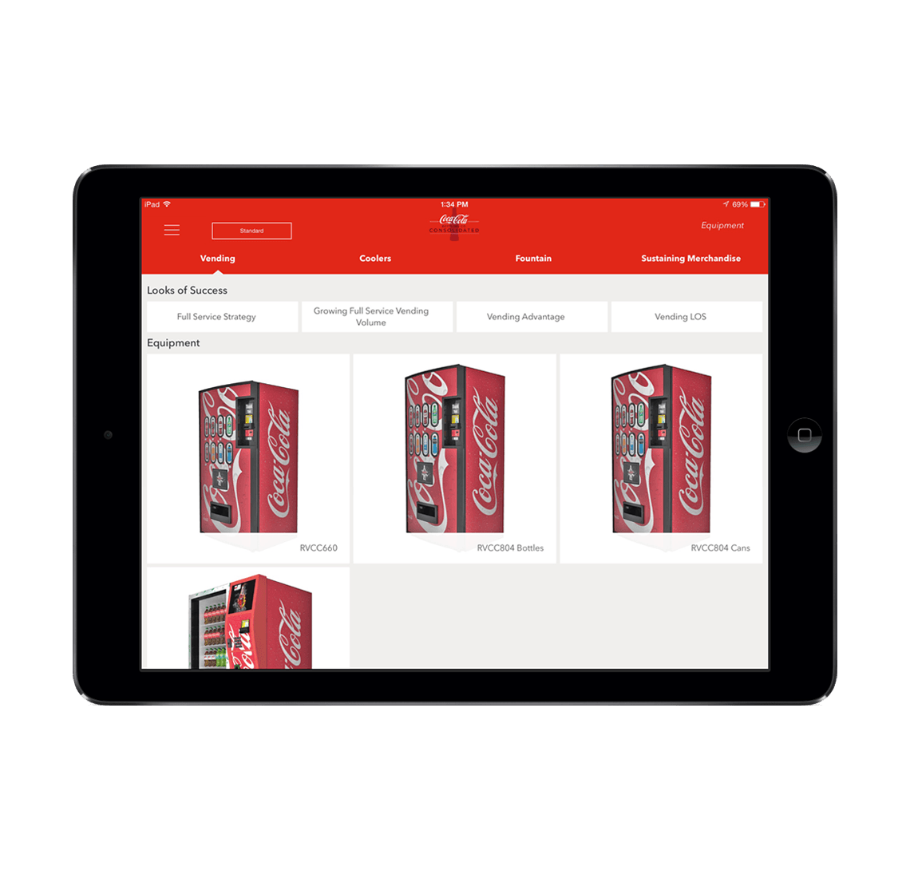



Xamarin App Architecture
.NET
C#
C#
C#
Shared C#
Business Logic • Platform APIs • User Interface
Notes:
First is the core architecture which enables huge amount of code sharing across apps. You can build stunning applications with high fidelity. Let’s talk about what is in each of these blocks, first with the head projects, platform APIs, and user interface. The business logic is just .NET code that can always be shared with other .NET platforms.

Slide 30












Native API Access
Notes:
The first part in the head projects is access to any of the unique APIs in iOS and Android. You have access to them all in C#. Now, these do have to be written in the head project and aren’t shared since they are unique to each platform. However, the Xamarin team has a way to help us out there.

Slide 31

Xamarin.Essentials
Secure Settings
Sms
Preferences
Flashlight
Clipboard
Gyroscope
Magnetometer
Geolocation
Phone Dialer
Device Display Info
Email
Device Info
Battery
Compass
Accelerometer
Screen Lock
Data Transfer
Text to Speech
Geocoding
File System
Connectivity
Vibration
aka.ms/xamarinessentials
Notes:
Which is Xamarin.Essentials. An open source library that abstracts common native features into a single cross platform API for iOS, Android, and Windows. These are APIs that exist across each platform so why not bring them together.

Slide 32
Xamarin.Essentials: Cross-Platform Native APIs
.NET
C#
C#
C#
Xamarin.Essentials
Shared C#
Business Logic • User Interface
Notes:
So now, if we look a bit further, this is what our app architecture looks like.

Slide 33

Xamarin.Forms
Notes:
What about the user interface? Just like APIs you can build the native UI for each platform. However, many developers choose to share all or most of the UI with Xamarin.Forms

Slide 34
What is Xamarin.Forms?

Slide 35
An open source mobile UI framework
from Microsoft for building
iOS, Android, & Windows apps with .NET
from a single shared codebase.

Slide 36
Xamarin.Forms: Cross-Platform Native UI
.NET
C#
C#
C#
Xamarin.Forms - UI
Xamarin.Essentials
Shared C#
Business Logic
Notes:
We will look more at Xamarin.Forms, but now we can see a full picture of what goes into our app.

Slide 37
Code Sharing
On average Xamarin developers share
80% of code
across mobile apps.
Notes:
Regardless of app approaches and if you need to mix in native APIs or UI in addition to Xamarin.Essentials and Xamarin.Forms, the average app shares nearly 80% of code.

Slide 38
Native performance
ARM BINARY
IL + JIT
.NET
.NET
.NET
AOT
.APP
Compile and Link
.APK
C#
C#
C#
Runs natively
Runs natively
Bindings
Bindings
Bindings
Xamarin.iOS does full Ahead Of Time (AOT) compilation to produce an ARM binary for Apple’s App Store.
Xamarin.Android takes advantage of Just In Time (JIT) compilation on the Android device.
Notes:
In addition, Xamarin apps fully compile down into native binaries for each platform.

Slide 39
✓ Always up-to-date
Same-day support:
iOS 5
iOS 6
iOS 7
iOS 8
iOS 9
iOS 10
iOS 11
iOS 12
Support for:
iOS Extensions
Apple Watch
Apple TV
Android Wear
Amazon Fire TV
and more
Notes:
To top it all off, Xamarin is on top of all the latest OS updates and additional platforms.

Slide 40

Integrations
Notes:
There is a lot more to Xamarin and .NET as there is a wonderful ecosystem that has built up around it over the years.

Slide 41












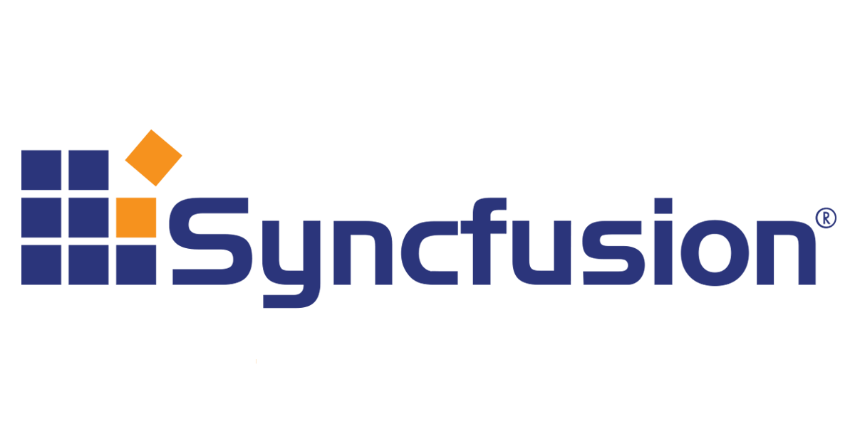

Libraries & Tools
Cognitive
Services
Azure Active
Directory B2C
Zxing
Barcode
Scanning
Akavache
Gorilla
Player
Zeplin
Notes:
First is libraries, essentially giving you anything that you need.

Slide 42





Frameworks
MVVMCross
Uno
ReactiveUI
Reactive Extensions
Notes:
There have even been specific frameworks for architecture and UI that have become industry standards.

Slide 43


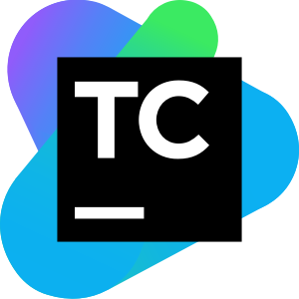



Continuous Integration & Delivery
Azure
Devops
Team
City
App
Center
Jenkins
Notes:
Not only does Xamarin work great with DevOps tools from Microsoft, but any CI and CD system out there.

Slide 44






Intelligent Clouds
IBM
MobileFirst
Firebase
Google
Cloud
Platform
Realm
Notes:
If you need a backend, Xamarin is open and you can use anything you desire.

Slide 45
Notes:
Naturally Xamarin and .NET apps work absolutely amazing for cloud apps with Microsoft Azure.

Slide 46










.NET cloud apps run best in Azure
Azure Storage
Azure Cosmos DB
Azure App Service
Azure Functions
Azure App Insights
Azure Service Fabric
Azure SignalR Service
Azure Virtual Machines
Azure SQL Database
Azure Cognitive Services
Azure Kubernetes Service (AKS)
And many more…
Extend apps with serverless, event driven tasks
Commoditized AI
Fully managed platform perfect for running .NET Framework and .NET Core web apps and services
Application performance and usability monitoring
Build native .NET, fully managed, scalable microservices
Relational Database
Non-Relational Database
Fully managed real-time web functions, like chat, gaming, tickers, collaboration and more
Store anything. Great for binaries
Container orchestrator for Linux workloads (.NET Core)
Notes:
No matter what you may need, there is a service in Azure for you. From serverless compute with Functions to realtime communication with SignalR, or databases with SQL and Cosmos DB there are great cross-platform SDKs for .NET.

Slide 47
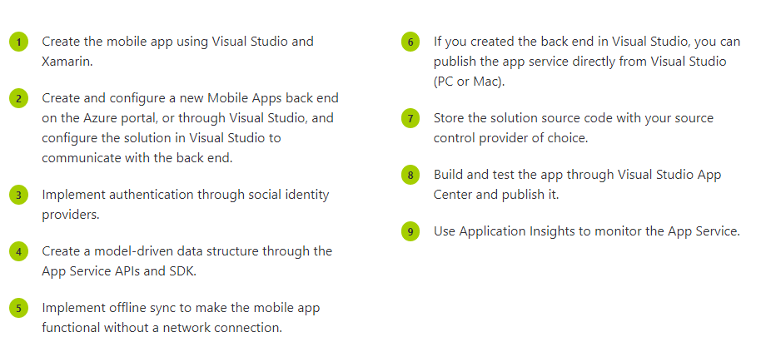
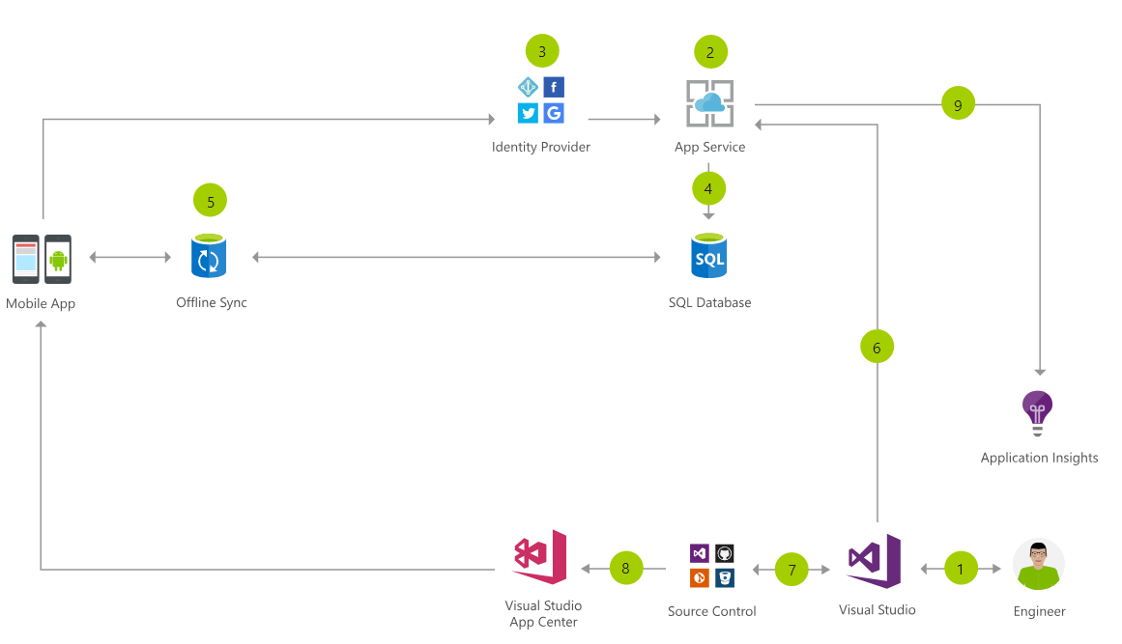
Cloud Mobile App Architecture
Notes:
Here is an example of what a cloud mobile app may look like.
You have your app, with identity providers with Azure AD B2C, and app service talking to SQLite and a sync later using App Service. You can export all of your data into App Insights and continuously monitor and ship with Azure DevOps and App Center.

Slide 48

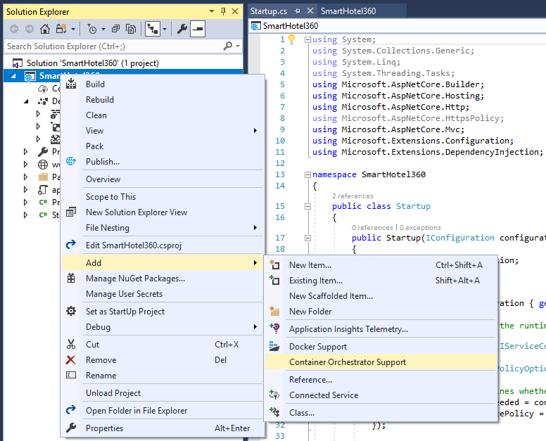
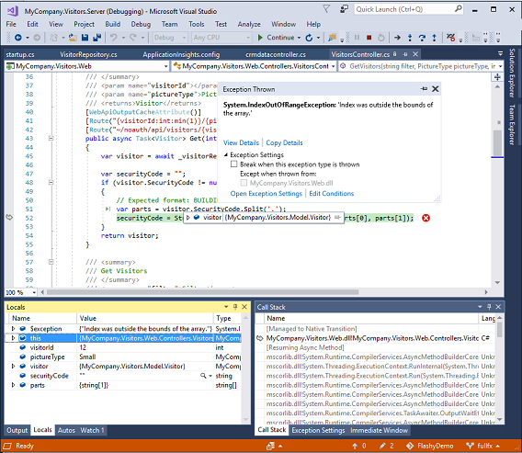
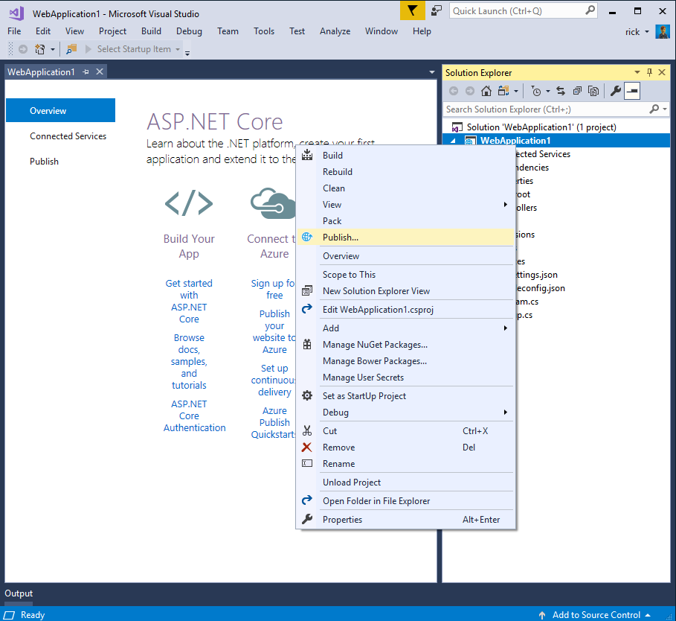
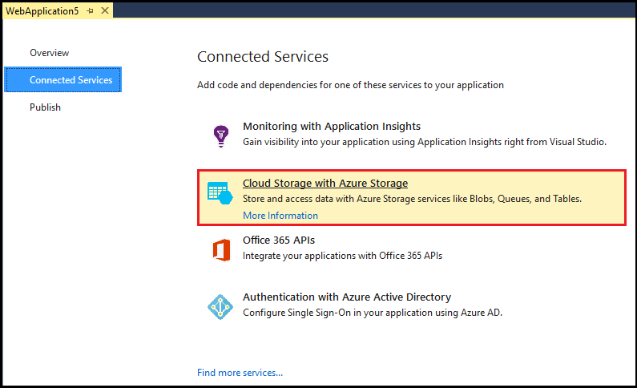
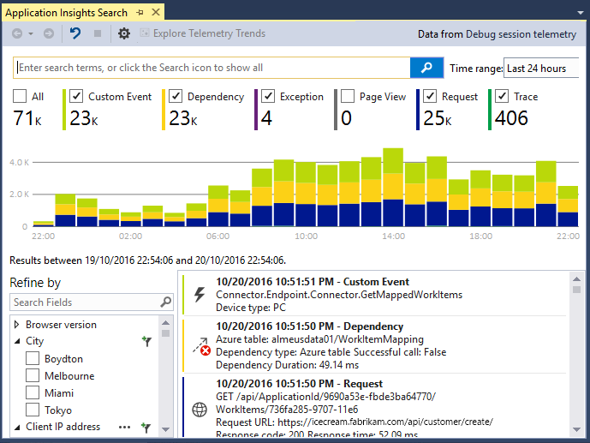
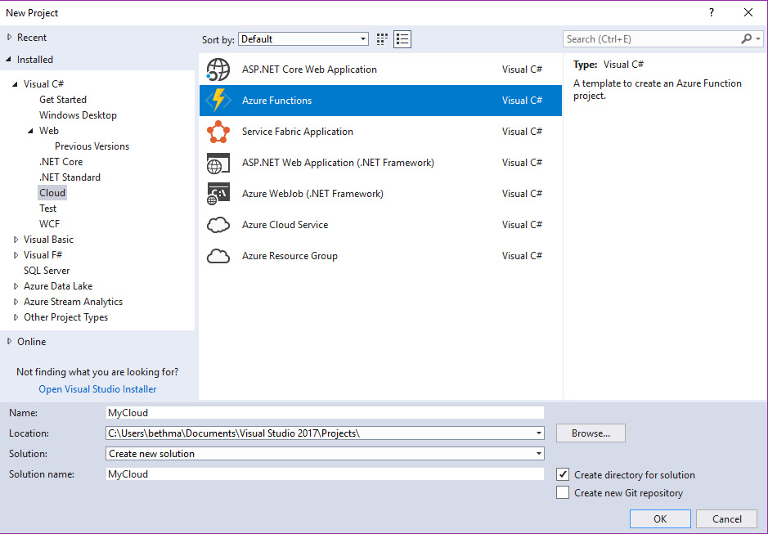
Accelerate your
development
cloud
Seamless Azure Integration
Publish directly to Azure without leaving the IDE
Connected Services
A new experience for easily discovering and extending your app with cloud services
Container Tools
Quickly add Docker compose and container orchestrator support to your apps
App Insights with Code Lens
Get a 360° view of your app that includes availability, performance and user behavior
Azure Functions
Get started quickly with serverless using templates and tools for development and debugging
Snapshot Debugging
Production debugging your cloud apps has never been so simple
Notes:
All of this is even built right into Visual Studio!

Slide 49
Azure DevOps
Complete DevOps solution
Code Repository
Build + Deploy
Test Cloud
User Beta Testing
Monitoring/Analytics
<//>
Developers
Notes:
Azure DevOps not only works great with Xamarin apps, but all apps! Giving you a full end to end develop lifecycle.

Slide 50


















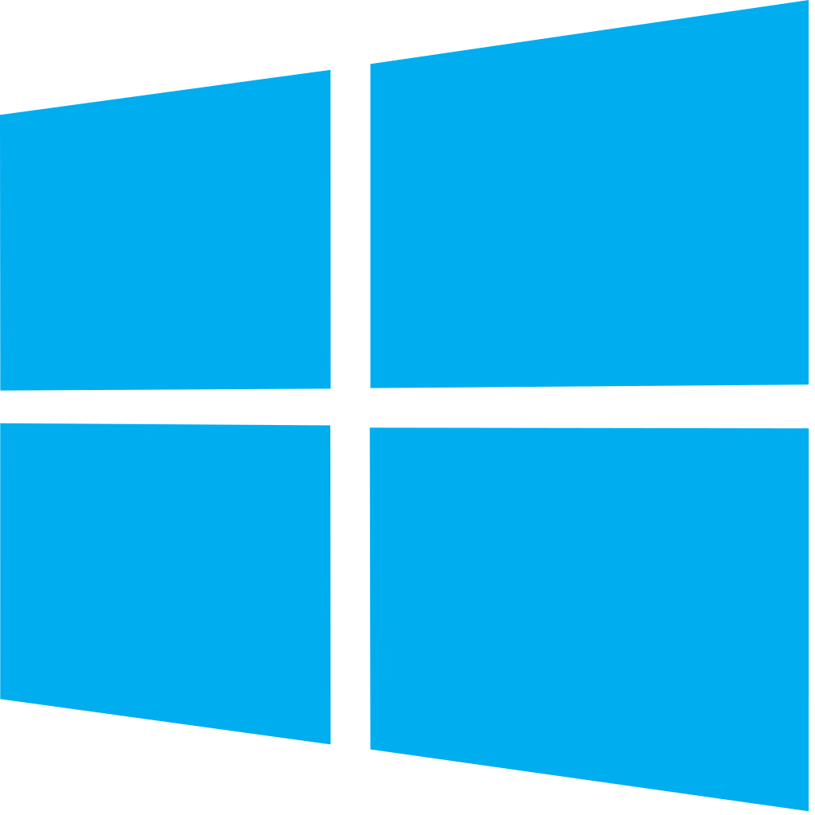
Azure DevOps: Choose what you love
Your tools, languages, and clouds
Azure DevOps lets developers choose the tools and languages that are right for them
Mix and match to create workflows with tools from Microsoft, open source or your favorite third-party tools
Target any cloud, on-prem or both and deploy to the servers you need
Notes:
You can pick and choose what you want to use and even integrate other clouds or on premise servers.

Slide 51
Azure DevOps
Azure Boards
Azure Pipelines
Azure Repos
Kanban Boards, Backlogs, Dashboards, and Reporting
CI/CD platform, FREE for open source projects
Unlimited, Cloud-Hosted Private Git Repos
Azure Test Plans
Azure Artifacts
Manual and Exploratory Testing Tools
Package Management for Maven, npm, and NuGet.
https://azure.com/devops
Notes:
There is tons of FREE in Azure DevOps to start today.

Slide 52
Xamarin.Forms Overview
Notes:
Alright, we have gone through .NET, the Ecosystem, and where Azure can help out, but let’s look more in-depth at Xamarin.Forms.

Slide 53
What’s included
.NET
✓ 40+ Pages, layouts, and controls
(Build from C# or XAML)
✓ Two-way data binding
✓ Navigation
✓ Visual State Manager
✓ Animation API
✓ Dependency Service
✓ Messaging Center
C#
C#
C#
Xamarin.Forms - UI
Xamarin.Essentials
Shared C#
Business Logic
Notes:
Xamarin.Forms is not just a UI library, it also contains full navigation, MVVM framework, Visual State Manager, Animation API, dependency services, and even a messaging center.

Slide 54
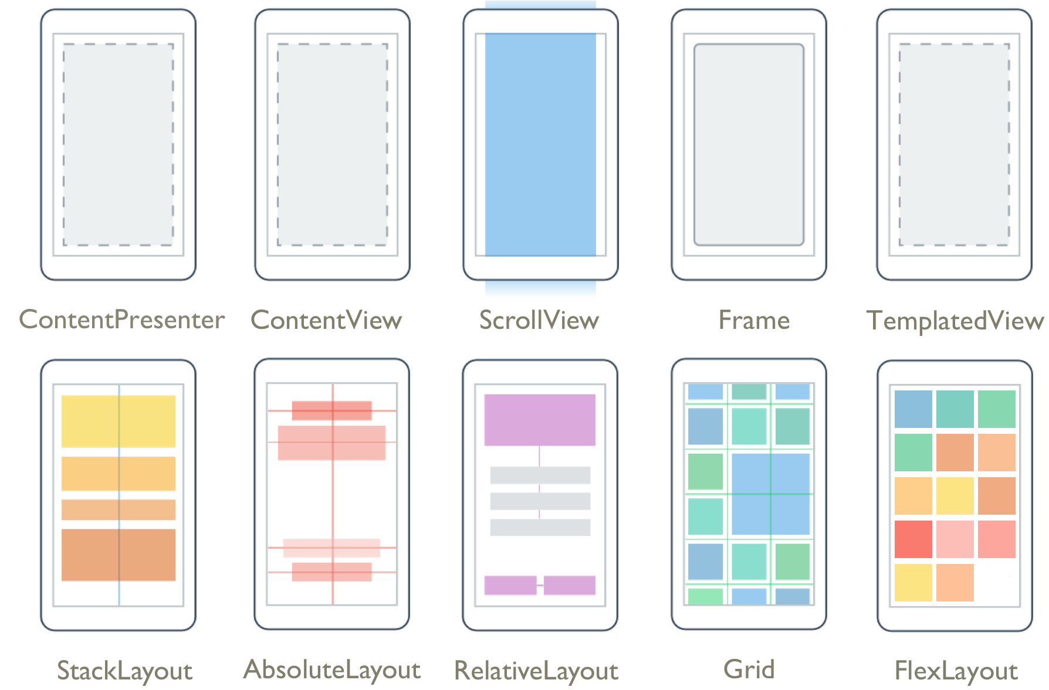
Pages & Layouts
Notes:
At the core are Pages and layouts of how you build your app. From a simple Stacklayout to Grids and even complex layouts with Flex to make really unique layouts that change with the orientation and device sizes.

Slide 55
Controls
ActivityIndicator
BoxView
Button
DatePicker
Editor
Entry
Image
Label
ListView
Map
OpenGLView
Picker
ProgressBar
SearchBar
Slider
Stepper
TableView
TimePicker
WebView
EntryCell
ImageCell
SwitchCell
TextCell
ViewCell
ImageButton
CarouselView
CollectionView
Notes:
Then there is the growing list of controls that you can use in your app. Each have several properties and events that you can optimize for your app.

Slide 56

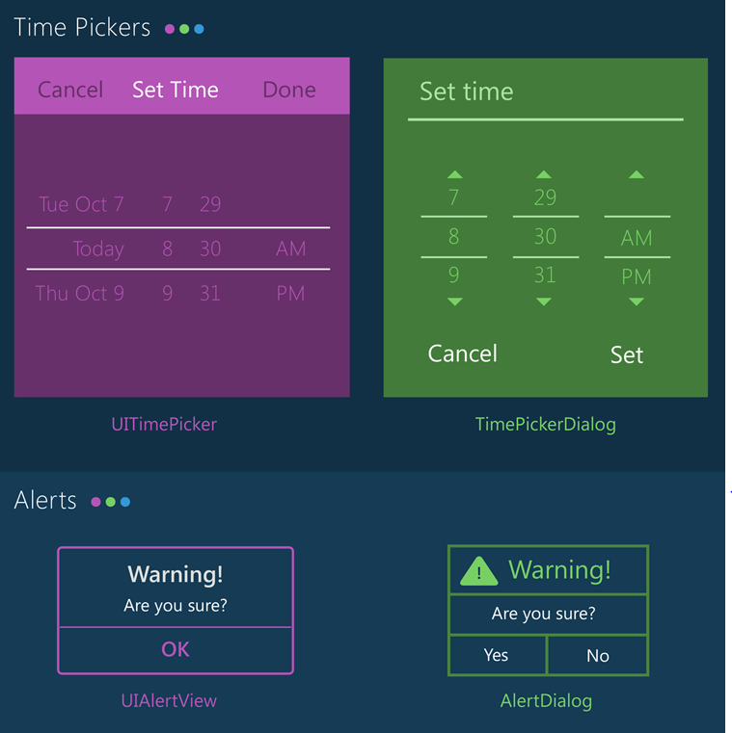
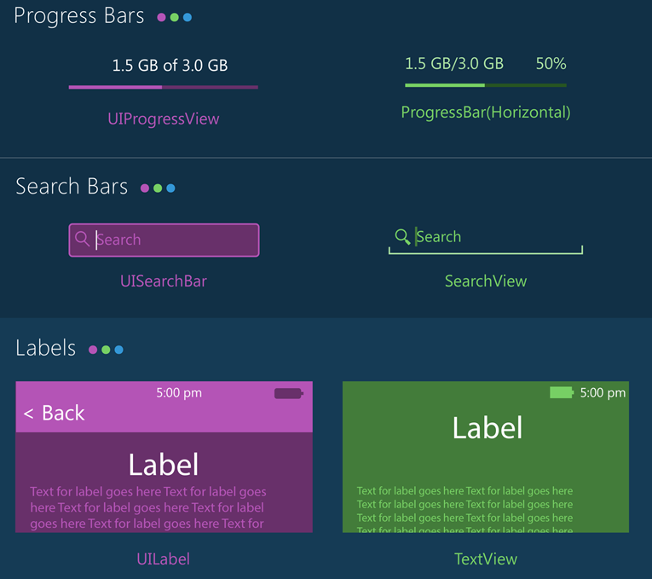
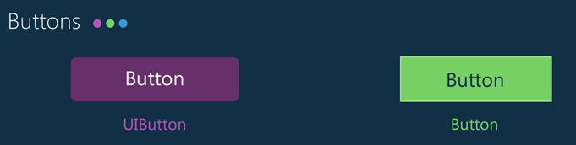
Notes:
With Xamarin.Forms you get the native controls on each platform so you app looks and feels native to the platform. However, with Xamarin.Forms and the new Visual API you can bring together your apps with a more similar material design look and feel.

Slide 57


Xamarin & Xamarin.Forms ecosystem
Notes:
If there is something not in the box, don’t worry as there is a huge ecosystem around Xamarin and Xamarin.Forms apps.

Slide 58
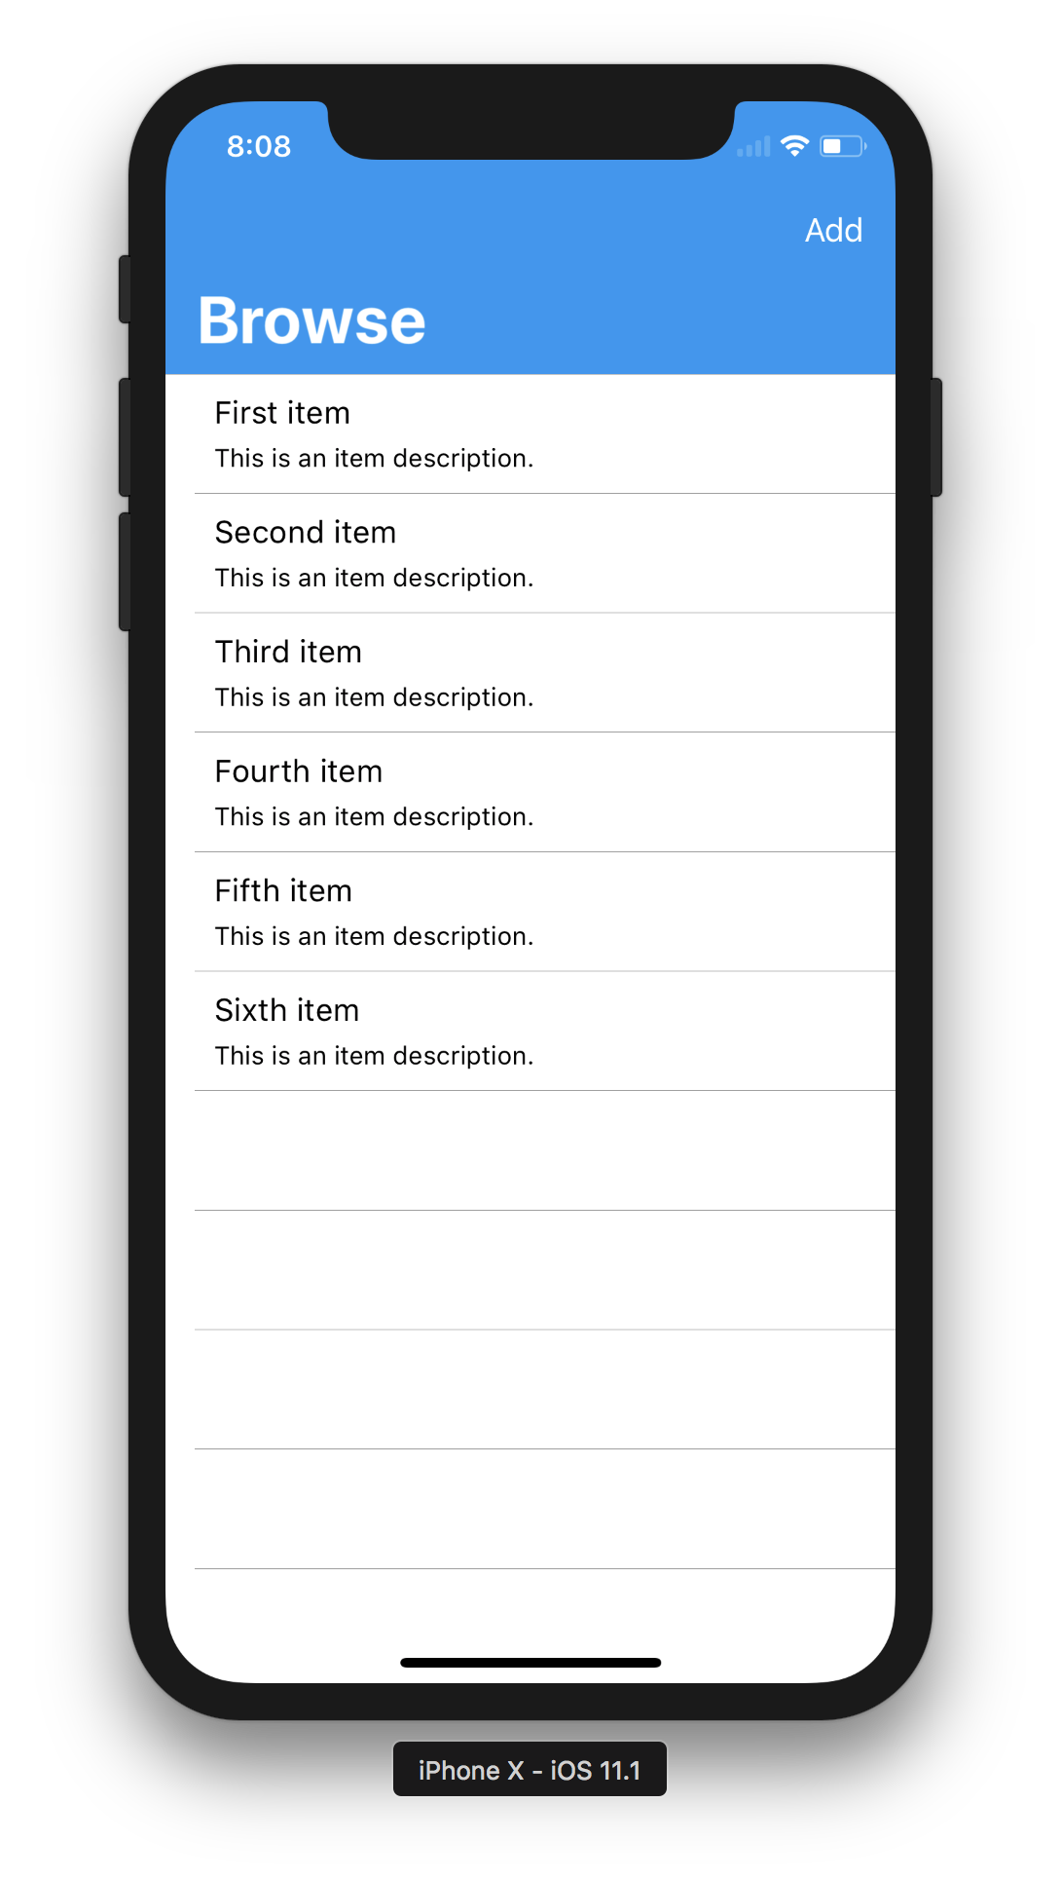
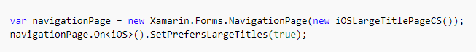
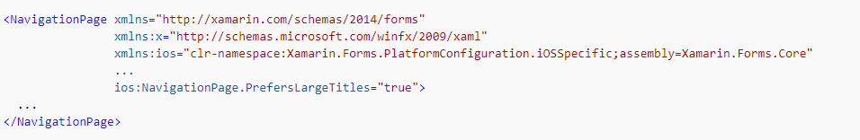
Platform Specifics
iOS Large Titles
C#
XAML
Notes:
Now, each platform is unique, which is why Xamarin.Forms offers platform specifics that can be called directly in shared code. So for instance if we want to enable large headers we can do it right in the XAML for iOS.

Slide 59
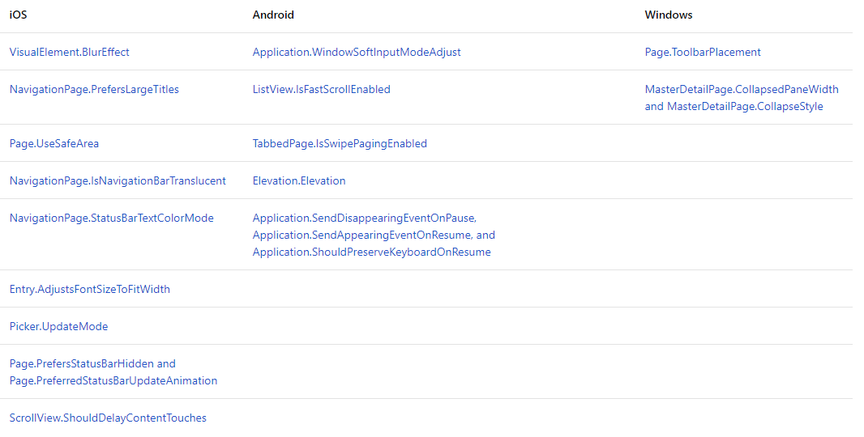
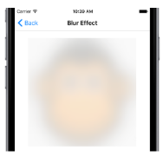
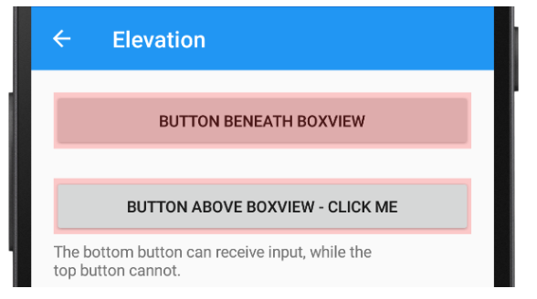


Platform Specifics
Built-in UI Tweaks
Notes:
And there are tons of these built in for each platform and growing!

Slide 60


Messaging Center
Master Page:
Detail Page:
Notes:
In addition, there are some common services such as a messaging center to do pub/sub across your app.

Slide 61
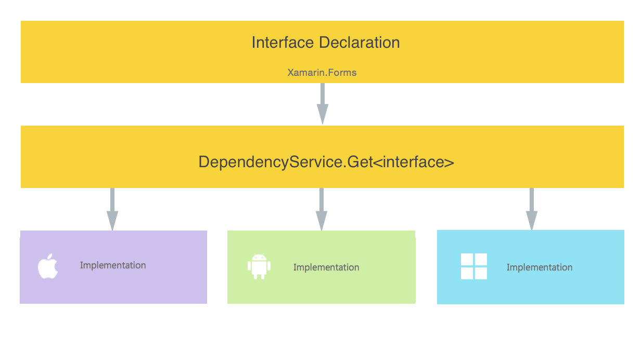
Dependency Service
Access Native Features Easily
Notes:
And a dependency service for interface based programming and to get into platform implementations.

Slide 62
Notes:
Now, let’s look deeper at what tools are built into Visual Studio for Xamarin developers.

Slide 63
Xamarin is included in Visual Studio
Xamarin is included
in Visual Studio
Including Community Edition!
Notes:
First, we should mention that Xamarin is part of Visual Studio! Including the free community edition! So if you already have Visual Studio, you have Xamarin and if you don’t it is free to make and ship apps.

Slide 64
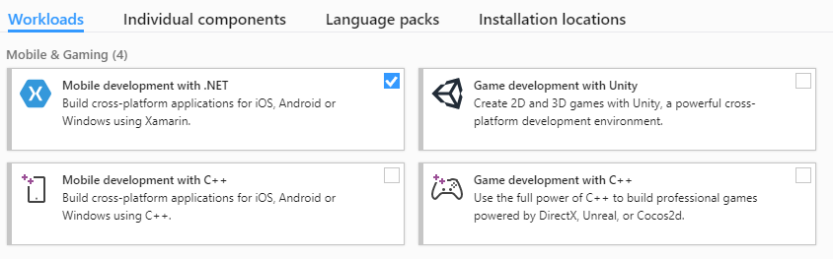
Visual Studio Integration
Notes:
It is easy to get started with just a single click.

Slide 65
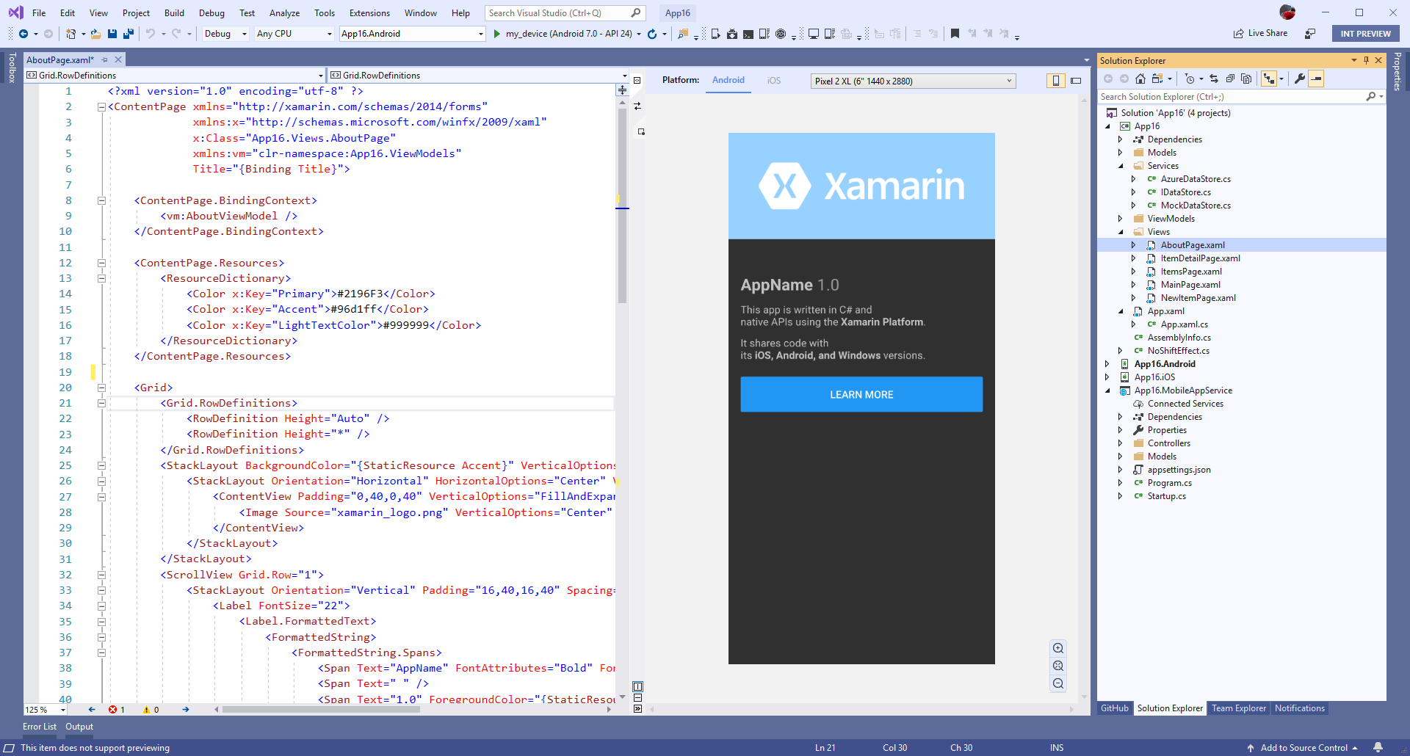
Xamarin.Forms Previewer
Quickly preview a visualization of your user interface
Drag & Drop Controls to XAML and modify in property panel
Target multiple screen sizes and resolutions of iOS & Android devices.
Preview data with design time attributes
Notes:
Built in is several designers and previewer for Xamarin.Forms for iOS and Android.

Slide 66
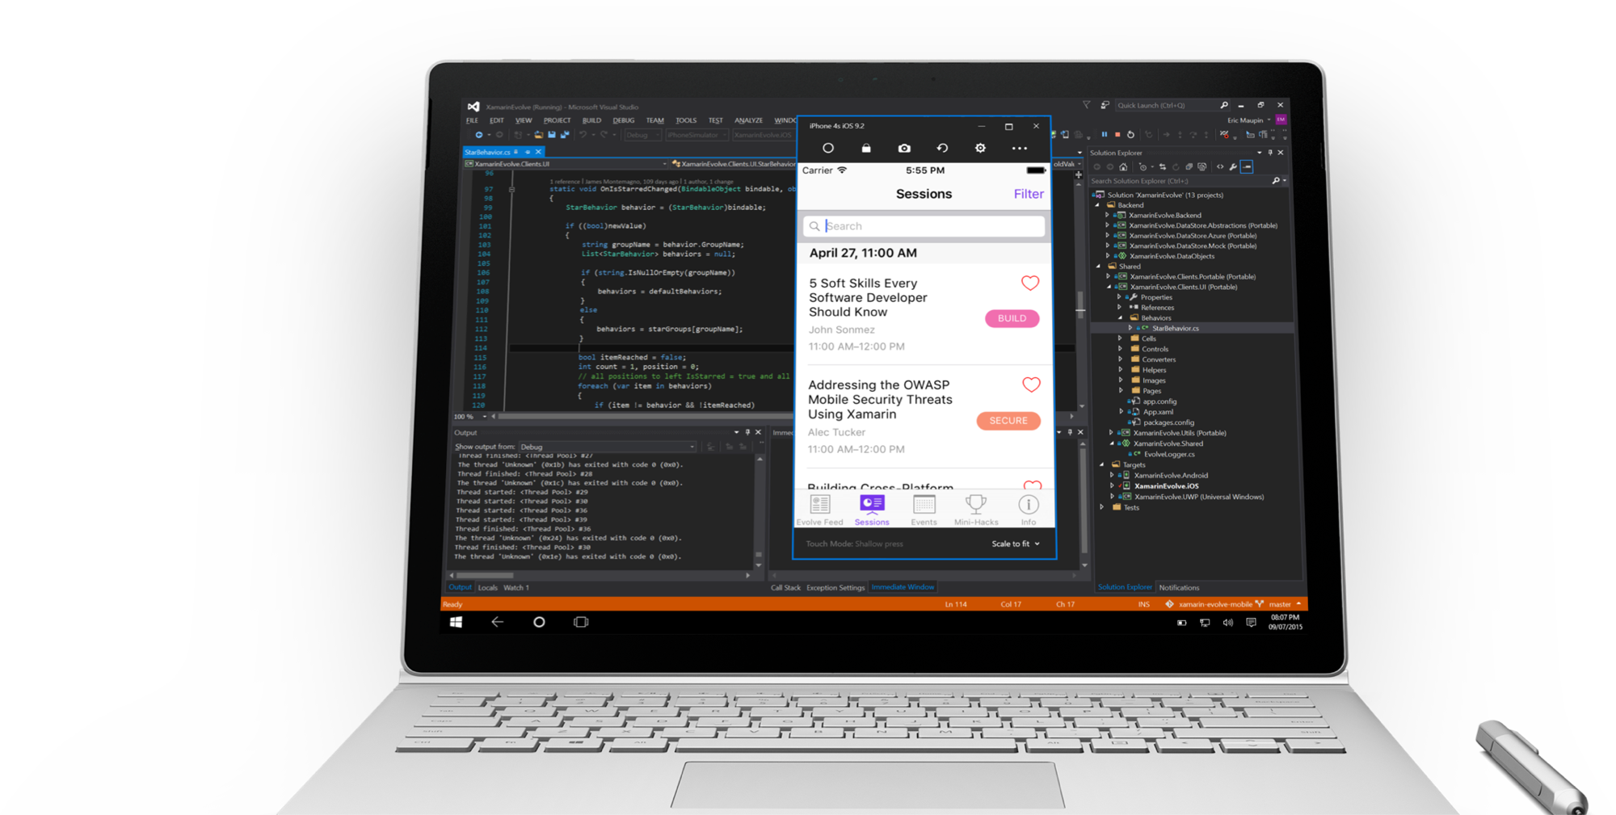
Visual Studio iOS Simulator Remoting
Multi-Touch Enabled
Pressure Sensitive
Super Fast
Rotate, screenshots, location changes
Never leave VS
Notes:
From your Windows machine you can directly launch the remoted iOS simulator!

Slide 67
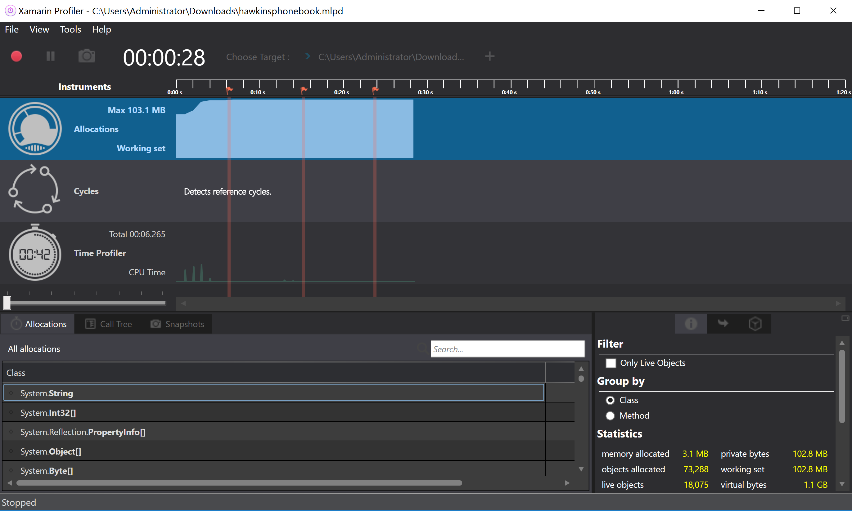
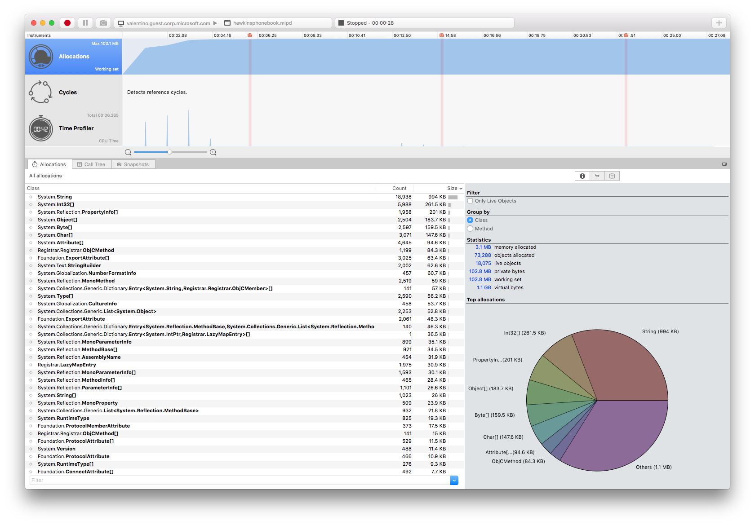
Xamarin Profiler
Analyze & Polish Apps
Key Instruments:
Allocations
Time Profiler
Cycles
Snapshots & More
*Enterprise
Notes:
If you are a Visual Studio enterprise customer you can take advantage of the profiling tools for Xamarin.

Slide 68



Visual Studio IntelliCode
Code with confidence
Find issues Faster
Focused code reviews
*VS 2019
Notes:
There is a lot more that Visual Studio offers such as intellicode which helps you write code faster with AI assisted Intellisense.

Slide 69
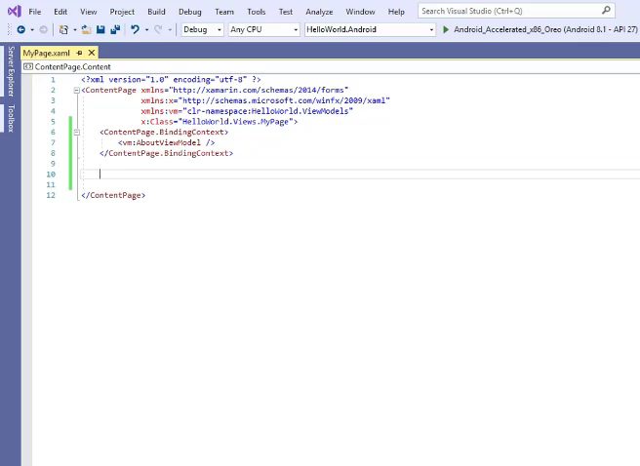
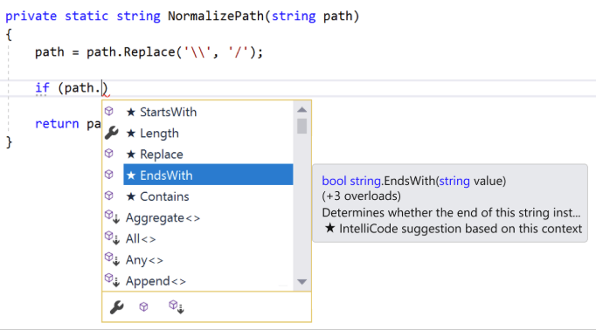
IntelliCode Support for C# & XAML
Assisted IntelliSense for C# & XAML
*VS 2019
Notes:
This works not only for C#, but also Xamarin.Forms XAML.

Slide 70
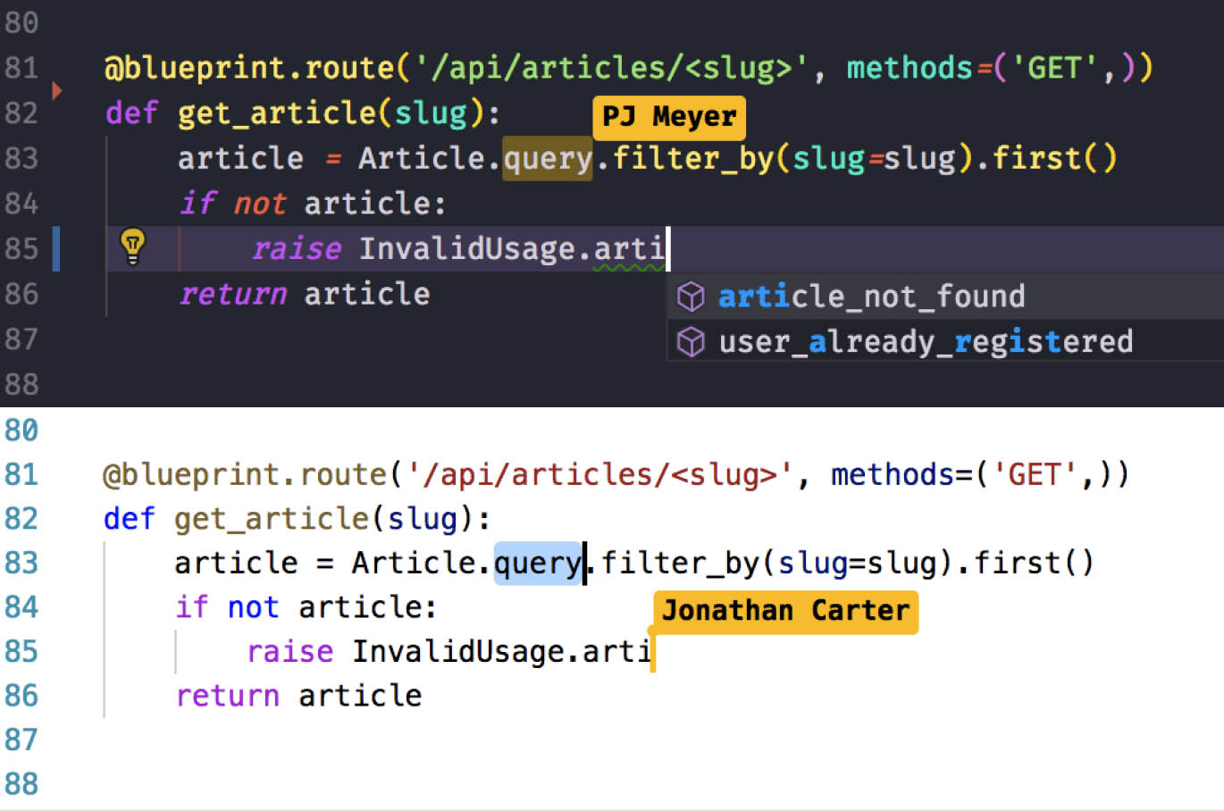
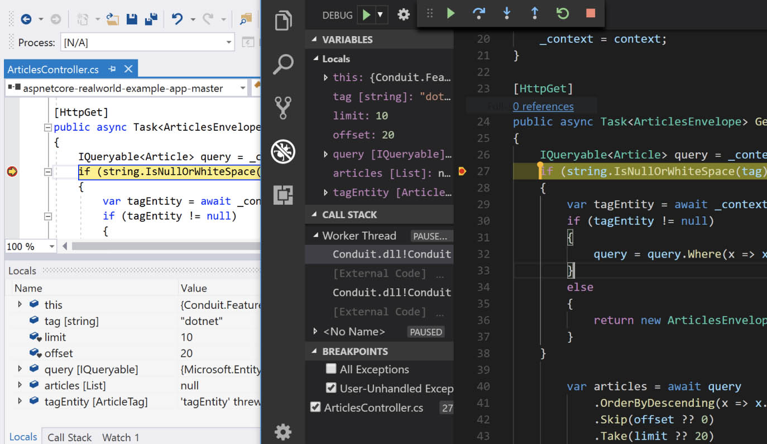
Visual Studio Live Share
Real-time collaborative development
No-hassle sharing for any language, any app
Collaborate from the comfort of your favorite tool
*VS 2019
Notes:
Since Xamarin apps are built inside of Visual Studio you can take advantage of other services such as Live Share to do collaborative coding.

Slide 71
Your platform for building anything
Desktop
Web
Cloud
Mobile
Gaming
IoT
AI
.NET
Notes:
So that is how Xamarin as part of the .NET platform enables you to reach even more platforms than ever and share code between all of your apps.

Slide 72
Get started today
xamarin.com

Slide 73
Thank you.
Names
Title
email
Website
@Twitter

